Slide 1
Mobile Application Testing – Overview

Slide 2
Why mobile app testing is necessary ?
These days, an increasing number of individuals and organizations are fighting for the top spot in app downloads. While many believe an app’s success depends on the type of program and its capabilities – and some of it does – the real difference between an app that sells and one that doesn’t is testing.
About half of the poor reviews on app stores are based on issues like crashes, network performance and battery drain.
Releasing a buggy app in the paly store with minimal testing can prove costly to an organization which is prone to getting negative reviews and less number of downloads
Mobile app testing provides the answer to these issues and can help developers prevent program failure.
The world is moving towards mobile from web and more number of organizations emphasize on mobile application development and testing to be a market leader in the domain

Slide 3
Types of mobile apps
Native apps are built for a specific operating system. A native app developed for iOS won’t work on Android devices, and vis-versa. If an app is developed on iOS, it will remain exclusive to that operating system unless an Android version is created. These apps are downloadable from application store (such as Google Play or Apple’s App Store). They are developed specifically for one platform, and can take full advantage of all the device features — such as the camera, the GPS, the accelerometer, the compass, the list of contacts, Gallery and so on. Example includes Whatsapp, Instagram, facebook etc. Native applications are implemented in the native language of the mobile phone itself: Objective-C for iOS, Java for Android and C# for Windows Phone are some of the most important languages.
Web apps are not real applications; they are really websites that, in many ways, look and feel like native applications, but are not implemented as such. Web apps are quick options for making existing content available via mobiles device. They utilize a device’s web browser to deliver content, such as Chrome, Firefox, Opera, Dolphin etc .We can view a mobile web app on an Android phone, an iOS tablet, a PC etc. A web app can be reframed as a mobile optimized webpage of a particular website
C) Hybrid apps or HTML 5 Write once run anywhere. A HTML5 app is, essentially, a mobile website which wrap their web views within native code to deliver content. As these apps require consistent internet connection, they limit the users’ capability to utilize them in low/no bandwidth areas. These apps will be built with the exact same function for every device; with no unique functions that users have come to expect in a mobile experience. These hybrid apps are usually face slowdown and other issues due to HTML 5 content. Due to this Facebook got away with hybrid apps in Sep 2012 and switched to native app for ios and android which were much faster in comparison to hybrid apps.

Slide 4
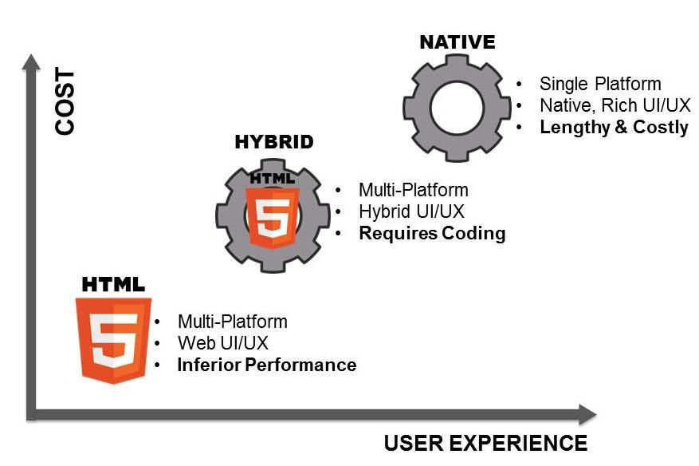
Native vs Hybrid vs Web apps

Slide 5
Significance of mobile app testing
Testing applications on mobile devices is more challenging than testing websites on desktop due to…
Different range of mobile devices with different screen sizes and hardware configurations like hard keypad, virtual keypad (touch screen) and trackball etc.
Wide varieties of mobile devices like HTC, Samsung, Moto, Apple and Nokia.
Different mobile operating systems like Android, Symbian, Windows, Blackberry and IOS.
Different versions of operation system like iOS 5.x, iOS 6.x, android 5.0 and 6.0
Different mobile network operators like GSM and CDMA.
Frequent software updates – (like android- 4.2, 4.3, 4.4, iOS-5.x, 6.x) – with each update a new testing cycle is recommended to make sure no application functionality is impacted.

Slide 6
Types of mobile app testing
Usability testing – To make sure that the mobile app is easy to use and provides a satisfactory user experience to the customers
Compatibility testing – Testing of the application in different mobiles devices, browsers, screen sizes and OS versions according to the requirements.
Interface testing – Testing of menu options, buttons, bookmarks, history, settings, and navigation flow of the application.
Low level resource testing : Testing of memory usage, auto deletion of temporary files, local database growing issues known as low level resource testing.
Performance testing – Testing the performance of the application by changing the connection from 2G, 3G to WIFI, sharing the documents, battery consumption, etc.
Operational testing – Testing of backups and recovery plan if battery goes down, or data loss while upgrading the application from store.
Installation tests – Validation of the application by installing /uninstalling it on the devices.
Security Testing – Testing an application to validate if the information system protects data or not.
Automation testing – Testing the functionality application in an automated way using the mobile app automation tools like Selendroid, Appium, MonkeyRunner, Robotium, Ranorex etc

Slide 7
Mobile application Testing Strategy
Selection of devices -- Analyze the market and choose the devices that are widely used. (This decision mostly relies on the clients. The client or the app builders consider the popularity factor of a certain devices as well as the marketing needs for the application to decide what handsets to use for testing.). Widely used devices include Samsung Galaxy series phones, Apple I phones, Nokia windows phones, Google nexus etc
Emulators -- The use of these is extremely useful in the initial stages of development, as they allow quick and efficient checking of the app. Emulator is a system that runs software from one environment to another environment without changing the software itself. It duplicates the features and work on real system. Examples include Device emulators for iPhone http://iphone4simulator.com/ or browser emulator for android which is available in Chrome
Physical devices – During initial stages of app development , testing on emulators can be considered. Once the app development gains a significant progress, it is recommended to test the app on real physical devices such as Android smart phone, Android TAB, iPhones, iPad, Blackberry, Windows Phone etc
Manual vs Automation testing – When the application is in the initial stages of development , test it manually on both emulators and devices to make sure the functionality is working fine. If the application is going through minor changes , test it manually. Once there are more number of regression tests, automate it using any of the mobile app automation tools such as Appuim, which can be used for both Android and ios, which saves considerable amount of time testing the regression tests on different devices and browsers.
Mobile app testing on the cloud -- running devices on multiple systems or networks via Internet where applications can be tested, updated and managed. For testing purposes, it creates the web based mobile environment on a simulator to access the mobile app.

Slide 8
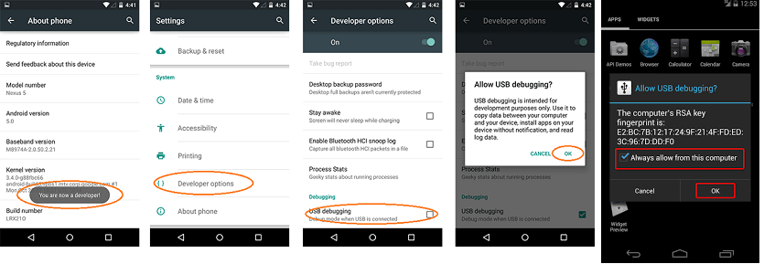
Manual testing on a local Android Device -- WebApp
Install the Android SDK on the machine. The SDK provides plenty of capabilities for testing native and hybrid apps - if we’re just testing a mobile site, many of these features won’t be relevant but nevertheless we have to install the entire SDK.
On Android 4 and newer, go to Settings > Developer Options and enable USB Debugging. If this option is hidden, go to Settings > About Phone and tap Build number seven times to get Developer options

Slide 9
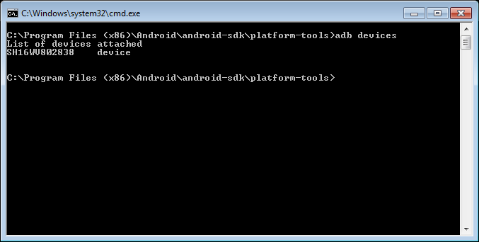
Set up your computer to detect the Android device via USB. This should work seamlessly on Mac OS X, and requires some drivers and configuration on Windows and Linux.
Connect the device to computer via USB cable and verify that the computer sees it, by running “adb devices” command on command prompt from your SDK platform-tools/ directory. If connected, you'll see the device name listed as a "device" (this “name” may be a cryptic ID number - but as long as you see something there, that’s probably your device).

Slide 10
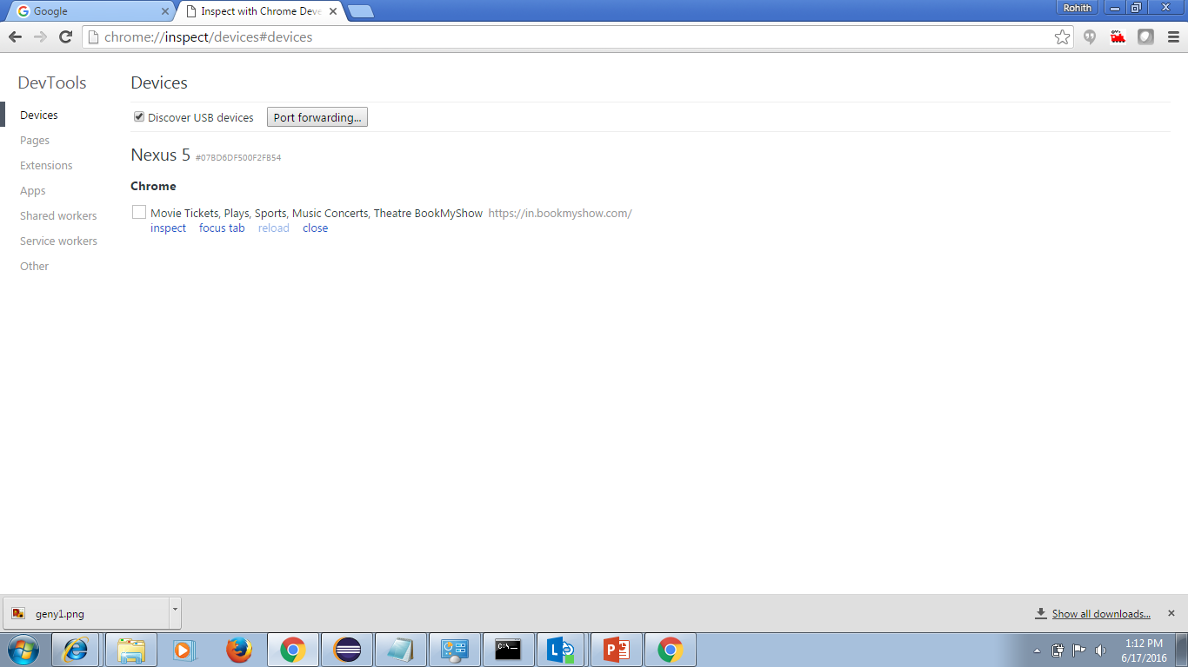
If we want to test a web app on the android device, open google chrome and launch http://www.bookmyshow.com for example
Now open chrome browser on PC and type chrome://inspect/devices#devices
From the list, below http://www.bookmyshow.com , click on Inspect link to see the browser emulator for webapp

Slide 11
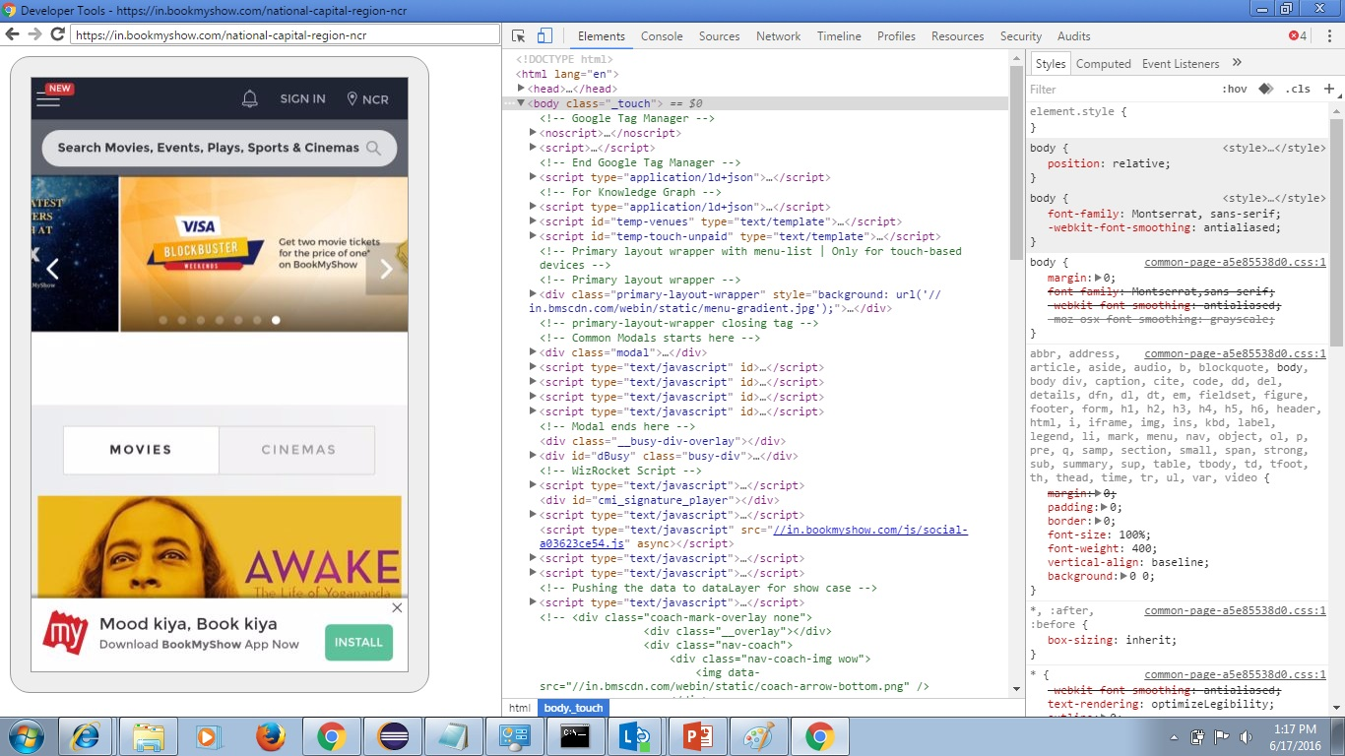
Chrome browser emulator for webApp -- interactive

Slide 12
Manual testing on a local android device – native app
Need to perform the same steps we did for web app
Additional step includes installation of native app to be tested via apk file or Eclipse
If tester has the access to the android project developer has developed, he can install the app in the android device using eclipse
If tester does not have the access to the android project, then dev sends an apk file to tester to install in the device
After installation we can test the native app for its functionality and UI/UX as per the requirement
We can use Fiddler debugging proxy to see the network calls of a native app after paring the device with fiddler proxy
Refer http://docs.telerik.com/fiddler/Configure-Fiddler/Tasks/ConfigureForAndroid

Slide 13
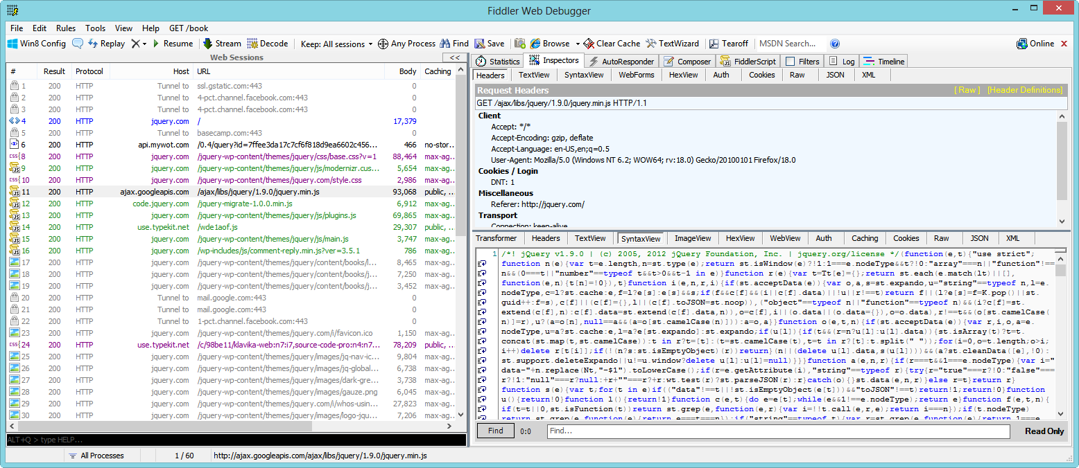
Fiddler debugging proxy to see android native app network calls

Slide 14
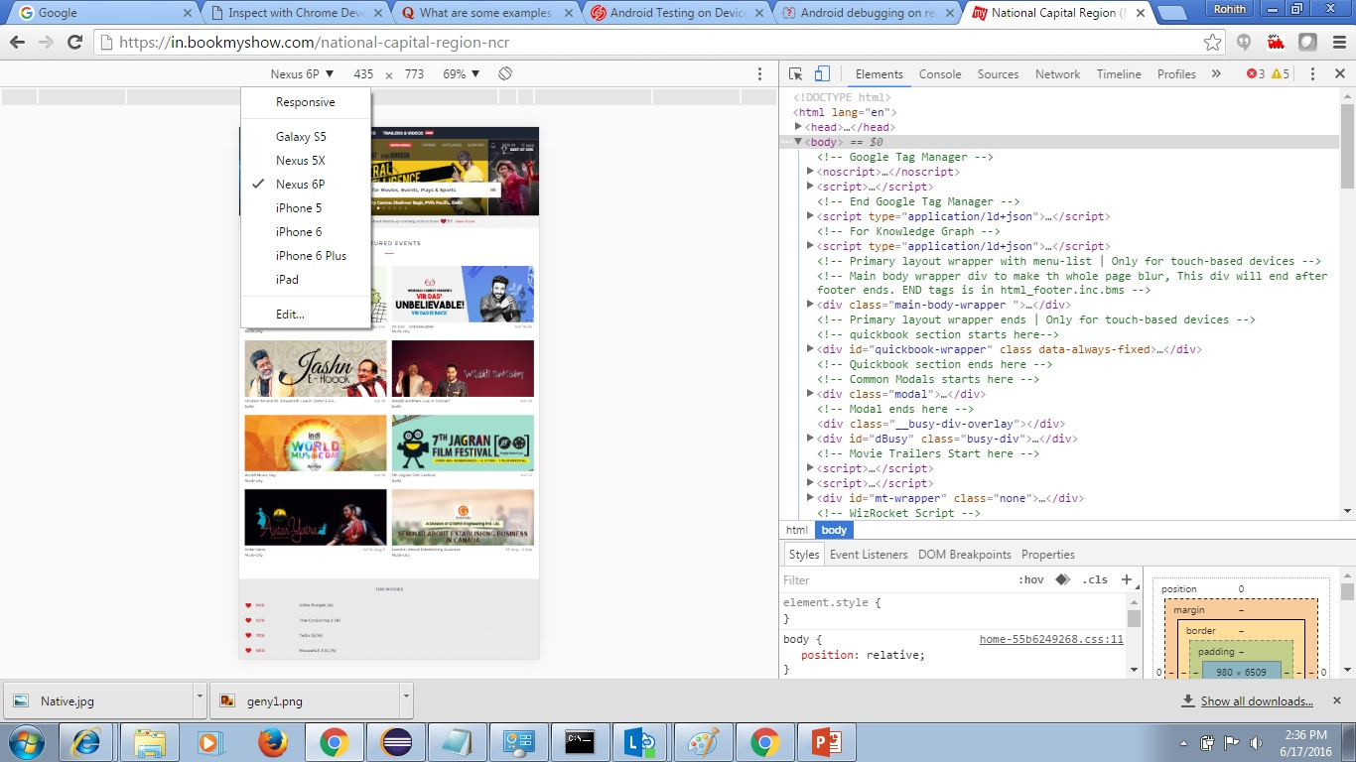
Emulators Testing native app on a Chrome built in emulator for mobiles – in case the test device is not available – this option is generally used by developers

Slide 15
Android emulators for Windows 7/8/10
There are a lot of valid reasons why someone would want to run Android emulators on their PC. App developers may be trying to test their application before shipping it out. Gamers may want to use a mouse and keyboard on their games. Maybe you just want it there to have it. In any case, Android emulation on PC is possible and we’re going to take a look at the best Android emulators for PC.
Following are the widely used android emulators for windows :
GenyMotion https://www.genymotion.com
BlueStacks www.bluestacks.com/
Droid4x http://droid4x.com/
Andyroid www.andyroid.net/
Duos M http://www.amiduos.com/

Slide 16
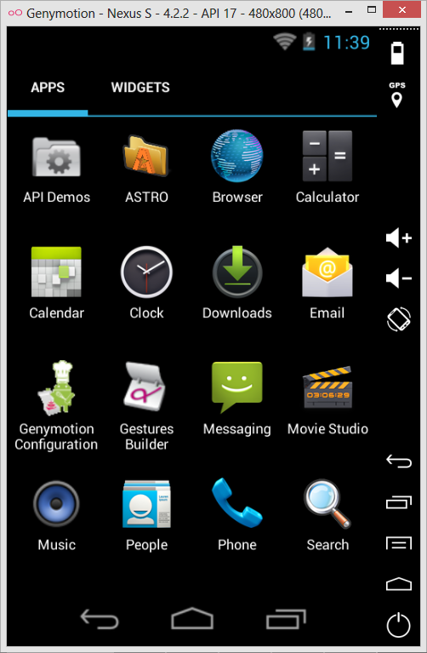
GenyMotion…

Slide 17
Ios simulator for Mac
The Simulator app, available within Xcode, presents the iPhone, iPad, or Apple Watch user interface in a window on your Mac computer. You interact with Simulator by using the keyboard and the mouse to emulate taps, device rotation, and other user actions
Refer https://developer.apple.com/library/ios/documentation/IDEs/Conceptual/iOS_Simulator_Guide/GettingStartedwithiOSSimulator/GettingStartedwithiOSSimulator.html

Slide 18
Android/ios mobile app test automation tools
Test Automation nowadays plays very important aspect in product testing. Hence more companies are focusing on providing Automated Testing services. There are multiple positives to go for test automation. This includes minimizing test execution time, ensuring larger coverage in less time in critical release phases, reliable and repetitive runs during product development phase to ensure no regression issues are introduced. Also it minimizes risk of human error or negligence while doing repetitive regression testing cycles. There are lot of tools available in market, both open source and paid ones
Calabash (Android and ios)
Appium (Android and ios)
MonkeyTalk (Android and ios)
Robotium (Android)
Selendroid (Android)
MonkeyRunner (Android)
Ranorex (Android)
UIAutomator (Android)
Frank (ios)

Slide 19
What’s next ?
Appium for Android automation in detail – for both webapp and native app

Slide 20
Q & A

Slide 21
Thank you!!

